Slide 1




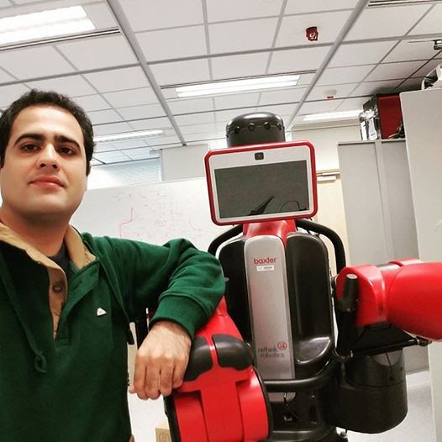
Research Profile
Dr. Muhammad Usman Maqbool bhutta
PhD, PEEF-Pakistan Scholar,
Robotics and Multi-perception Lab (RAM-LAB),
Department of Electronic and Computer Engineering, HKUST, HK
Personal Website: usmanmaqbool.github.io

Slide 2
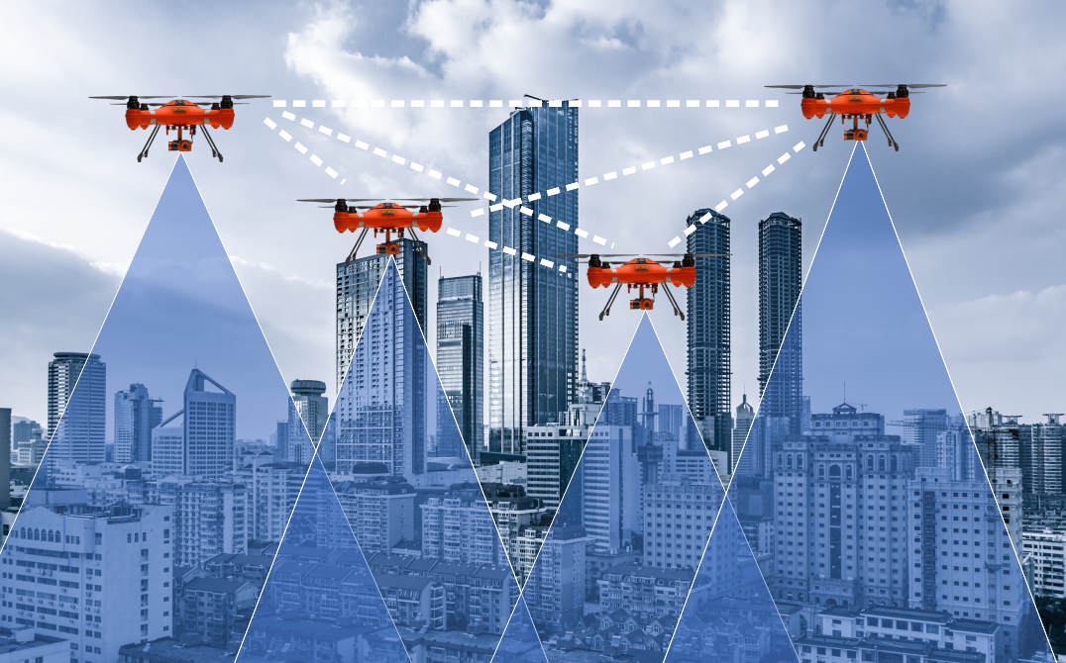
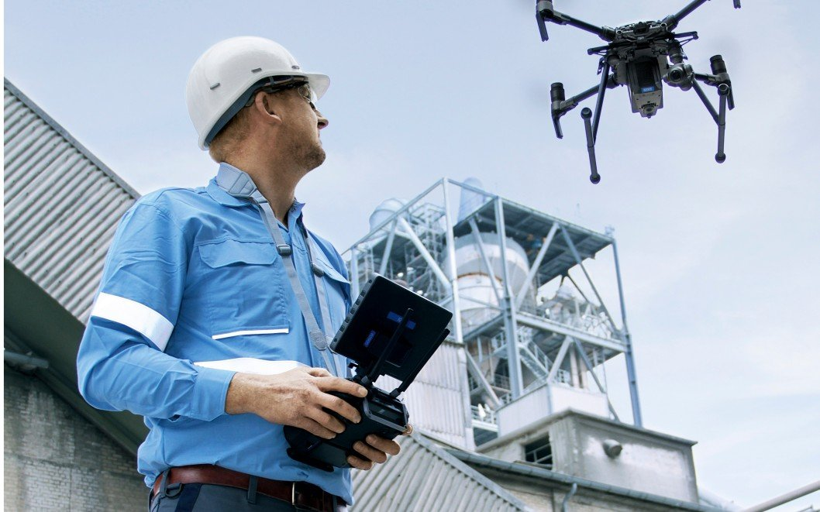
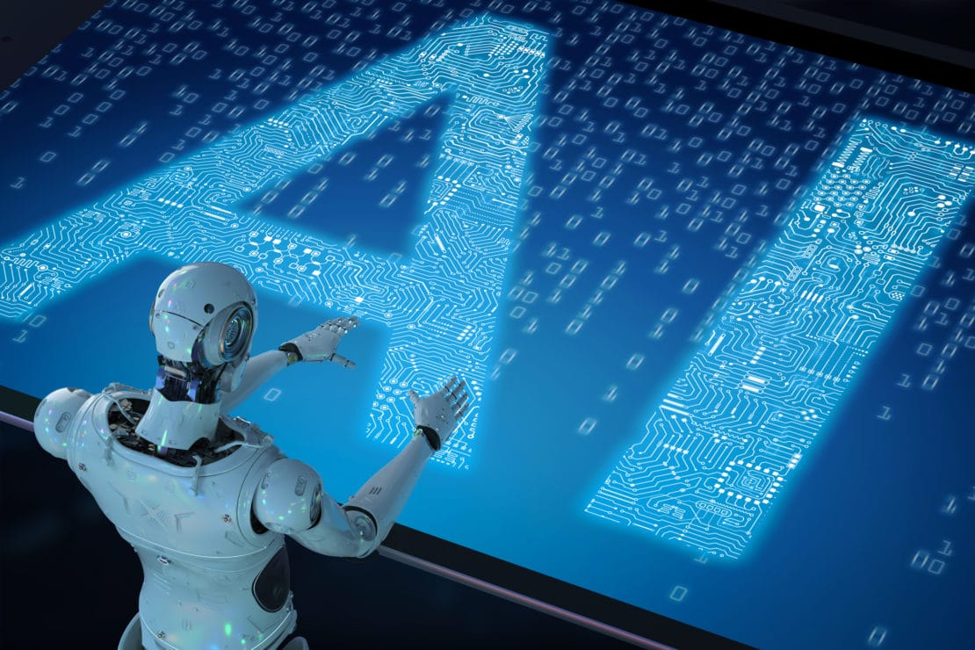

Research Interests
Collaborative SLAM and 3D-Mapping
Inspection Systems
Deep Learning (Place recognition)
Augmented Reality (AR)
Virtual Reality (VR)

Slide 3
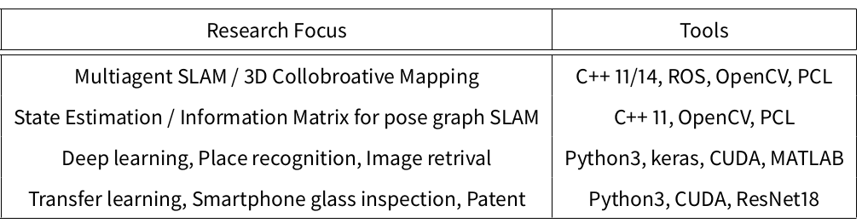
Research Works
Corresponding Author
1
Loop-Box
2
PCR-PRO
3
MAQBOOL
4
Smart-Inspect
Notes:
Lets start from the presentation plan
First I’ll start from introduction of Pose graph simultaneous localization and mapping system including multi-agent
Problem statements and key challenges towards a swift multi-agent slam system
PCR-Pro will help deal with problems related to Point cloud alignment, scaling and estimation of accurate relative transformation is mandatory for building a connection between two agents in a multiagent SLAM sytem.
For a swift multiagent SLAM system, there is a need for a framework that accepts mapping information from different approaches and camera systems. The Loop-box system can work collaboratively to make a large-scale 3D-map based on semi-dense or sparse SLAM approaches.
MAQBOOL probabilistically elevates the perceptible regions' distributions for improving the loop closure module of the multiagent SLAM system.
Then we will move towards …. Final conclusion and future work,

Slide 4
Multiagent SLAM > Loop-box
Single Loop Closure Based Agents’ Fusion
1
Loop-Box
For a swift multiagent SLAM system, there is a need for a framework that accepts mapping information from different approaches and camera systems. The Loop-box system can work collaboratively to make a large-scale 3D-map based on semi-dense or sparse SLAM approaches.
M Usman Maqbool Bhutta, Manohar Kuse, Rui~Fan, Yanan Liu, Ming Liu, Loop-box: Multi-Agent Direct SLAM Triggered by Single Loop Closure for Large Scale Mapping, IEEE Transactions on Cybernetics.2020. (IF: 11+)

Slide 5
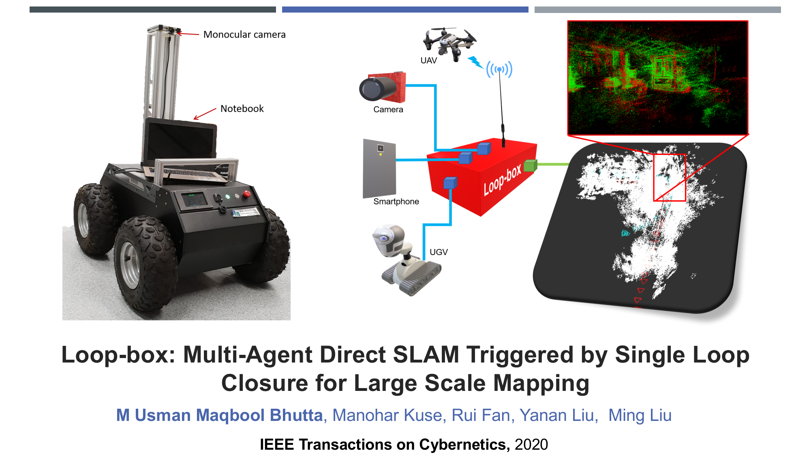
Main Contributions
Multi-Agent SLAM > Loop-box
We propose a multiagent direct SLAM system that can merge 3-D maps with different scales to a global representation.
Demo: https://www.youtube.com/watch?v=AatjVz5ysV8

Slide 6
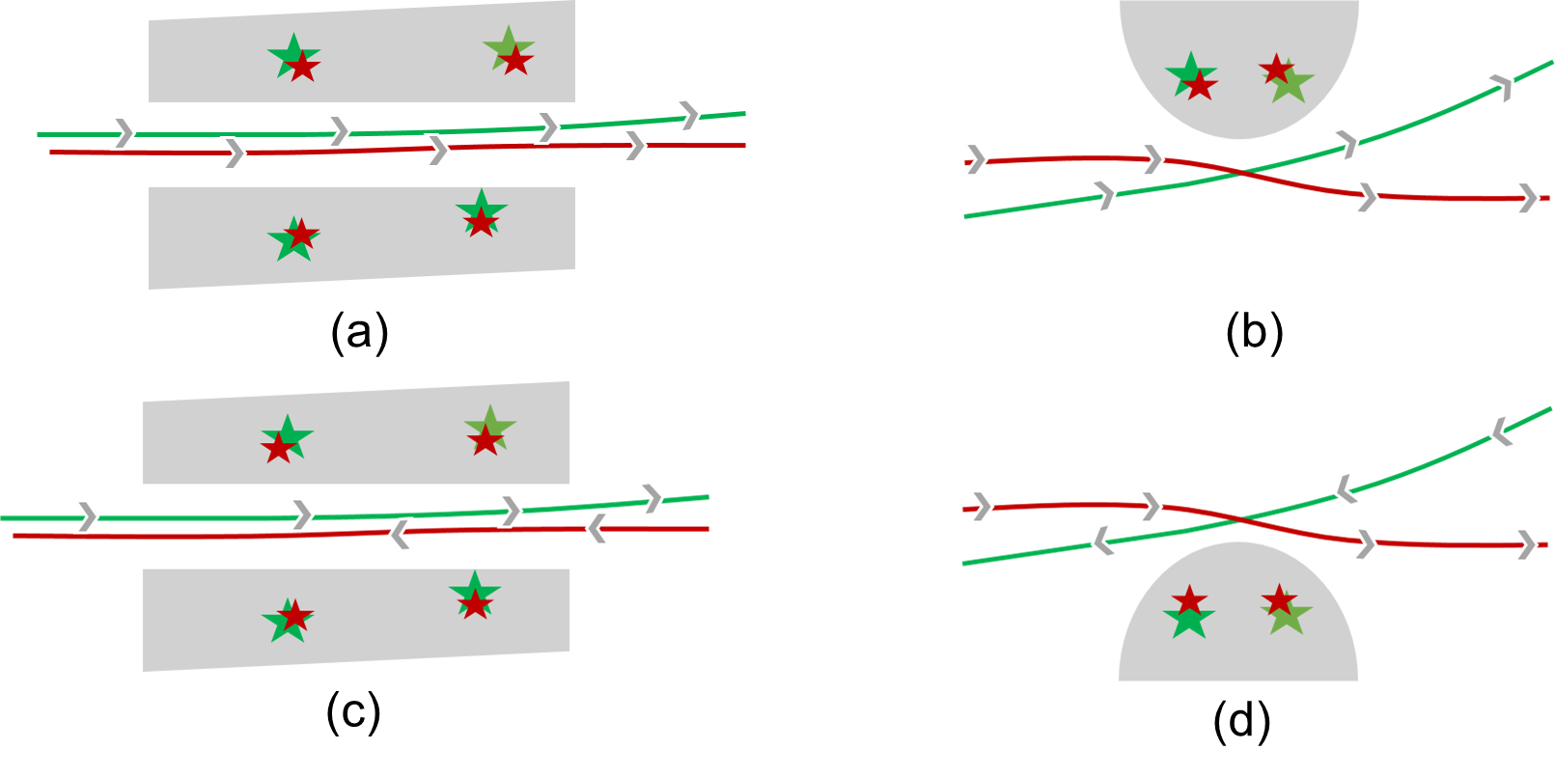
Main Contributions
Multi-Agent SLAM > Loop-box
We propose a multiagent direct SLAM system that can merge 3-D maps with different scales to a global representation.
The system is robust and can accurately determine the relative change between multiple robots during a very short interval (Fig. 1.2b, 1.2d). In particular, no previous study, to our knowledge, has considered short intervals.
Demo: https://www.youtube.com/watch?v=AatjVz5ysV8

Slide 7
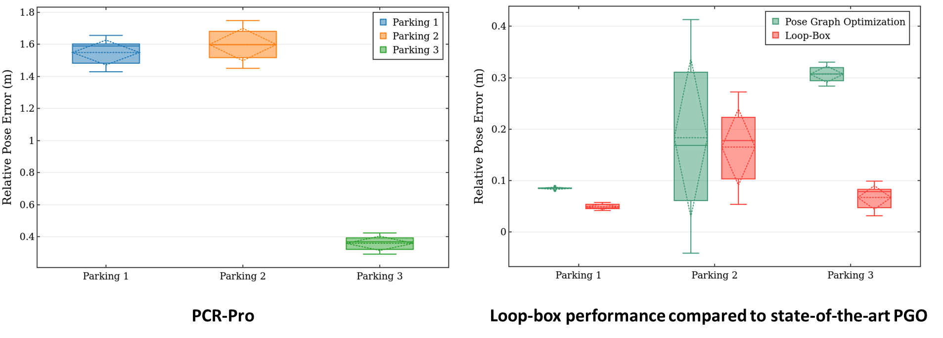
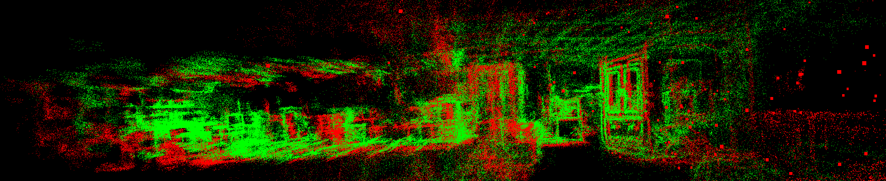
Main Contributions
Multi-Agent SLAM > Loop-box
We propose a multiagent direct SLAM system that can merge 3-D maps with different scales to a global representation.
The system is robust and can accurately determine the relative change between multiple robots during a very short interval (Fig. 1.2b, 1.2d). In particular, no previous study, to our knowledge, has considered short intervals.
The system can collaborate pairwise directly. Therefore, each of the agent scan estimate the relative pose transformation and registering of the 3-D maps after the first loop closure.
Demo: https://www.youtube.com/watch?v=AatjVz5ysV8

Slide 8
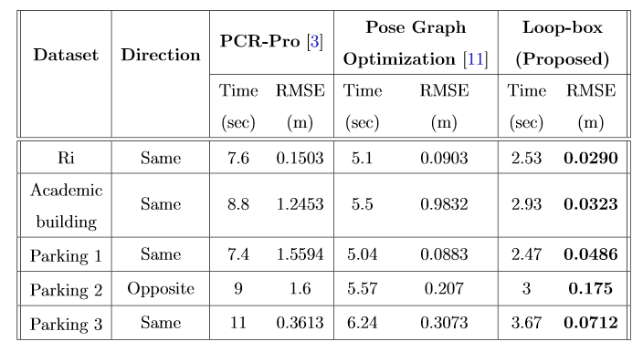
Main Contributions
Multi-Agent SLAM > Loop-box
We propose a multiagent direct SLAM system that can merge 3-D maps with different scales to a global representation.
The system is robust and can accurately determine the relative change between multiple robots during a very short interval (Fig. 1.2b, 1.2d). In particular, no previous study, to our knowledge, has considered short intervals.
The system can collaborate pairwise directly. Therefore, each of the agent scan estimate the relative pose transformation and registering of the 3-D maps after the first loop closure.
We present a single-loop closure-based method that welcomes features to direct SLAM methods for large-scale 3-D collaborative mapping. This allows the proposed framework to work effectively in any of the states.
Relative pose RMSE of the proposed method compared to PCR-Pro and pose-graph optimization
R. Kummerle, G. Grisetti, H. Strasdat, K. Konolige, and W. Burgard, “g²o: A general framework for graph optimization,” in 2011 IEEE International Conference on Robotics and Automation, pp. 3607–3613, IEEE, May 2011.
M. U. M. Bhutta and M. Liu, “PCR-Pro: 3d sparse and different scale point clouds registration and robust estimation of information matrix for pose graph SLAM,” in 2018 IEEE 8th Annual International Conference on CYBER Technology in Automation, Control, and Intelligent Systems (CYBER), pp. 354–359, 2018.
Demo: https://www.youtube.com/watch?v=AatjVz5ysV8

Slide 9
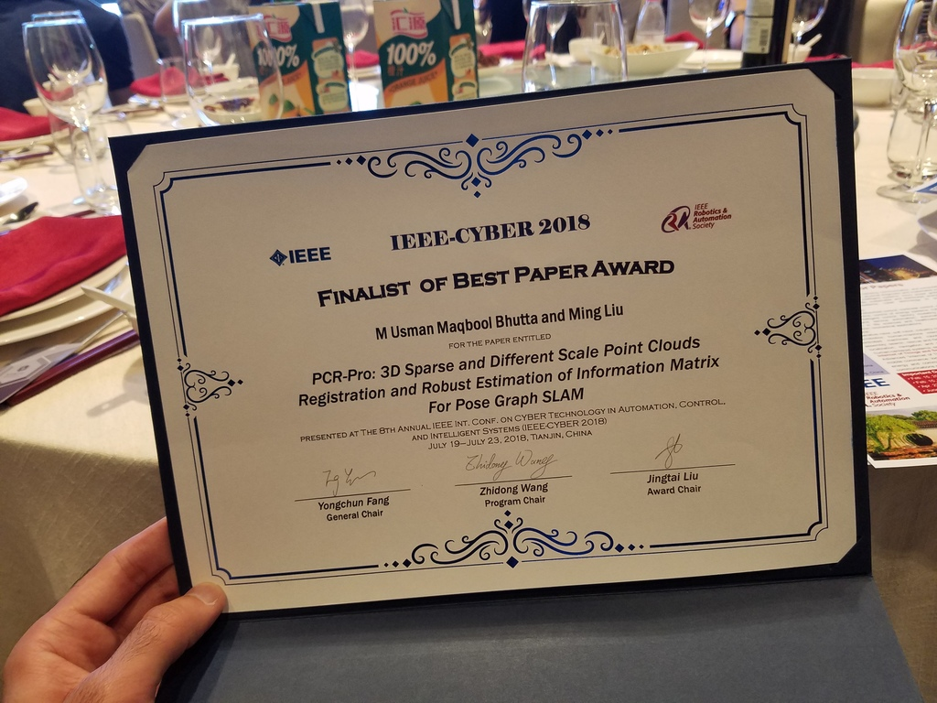
SLAM > PCR-Pro
Point Cloud Registration
2
PCR-Pro
Point cloud alignment, scaling and estimation of accurate relative transformation is mandatory for building a connection between two agents in a multiagent SLAM system. PCR-Pro will help deal with such problems.
Bhutta, M.U.M. and Liu, M., 2018, July. Pcr-pro: 3d sparse and different scale point clouds registration and robust estimation of information matrix for pose graph slam. In 2018 IEEE 8th Annual International Conference on CYBER Technology in Automation, Control, and Intelligent Systems (CYBER) (pp. 354-359). IEEE.

Slide 10
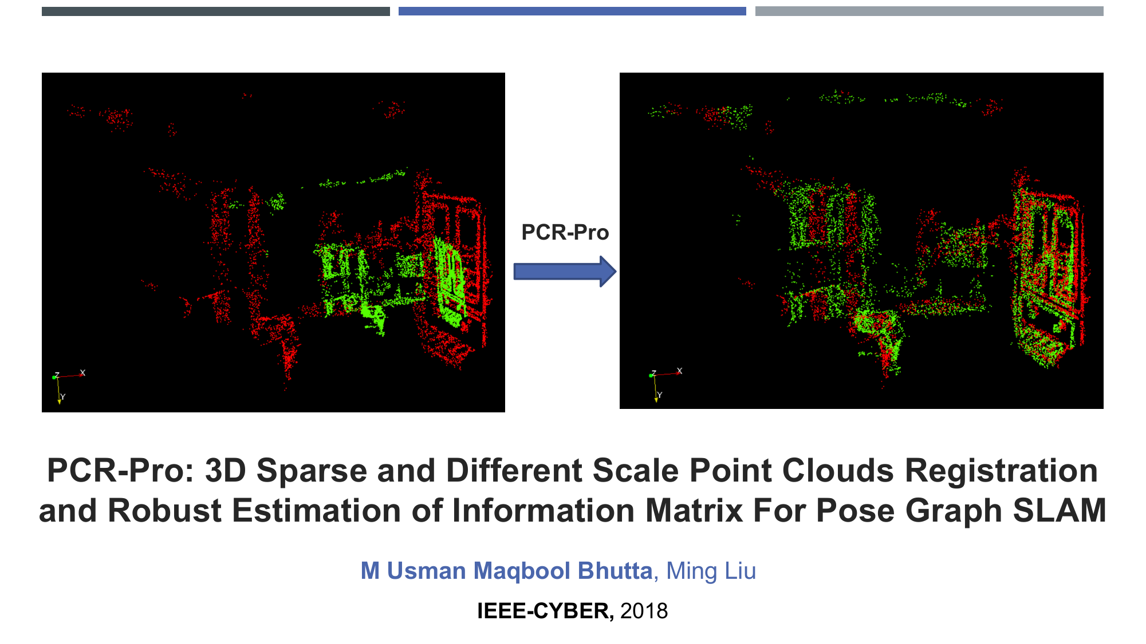
Main Contributions
Point Cloud Registration > PCR-Pro
We introduce a way of using direct SLAM approaches for multiagent SLAM systems where we do not have information of the scale difference.

Slide 11
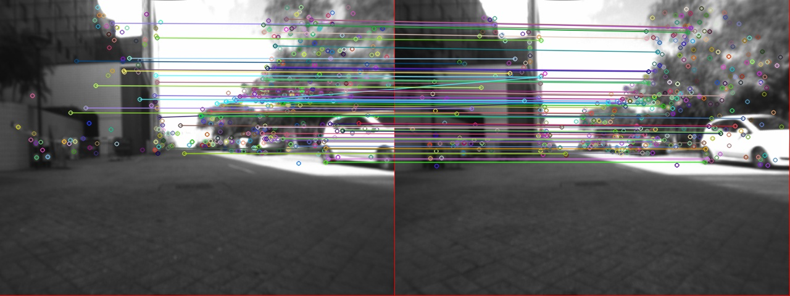
Main Contributions
Point Cloud Registration > PCR-Pro
We introduce a way of using direct SLAM approaches for multiagent SLAM systems where we do not have information of the scale difference.
We introduce feature data to featureless SLAM approaches.

Slide 12
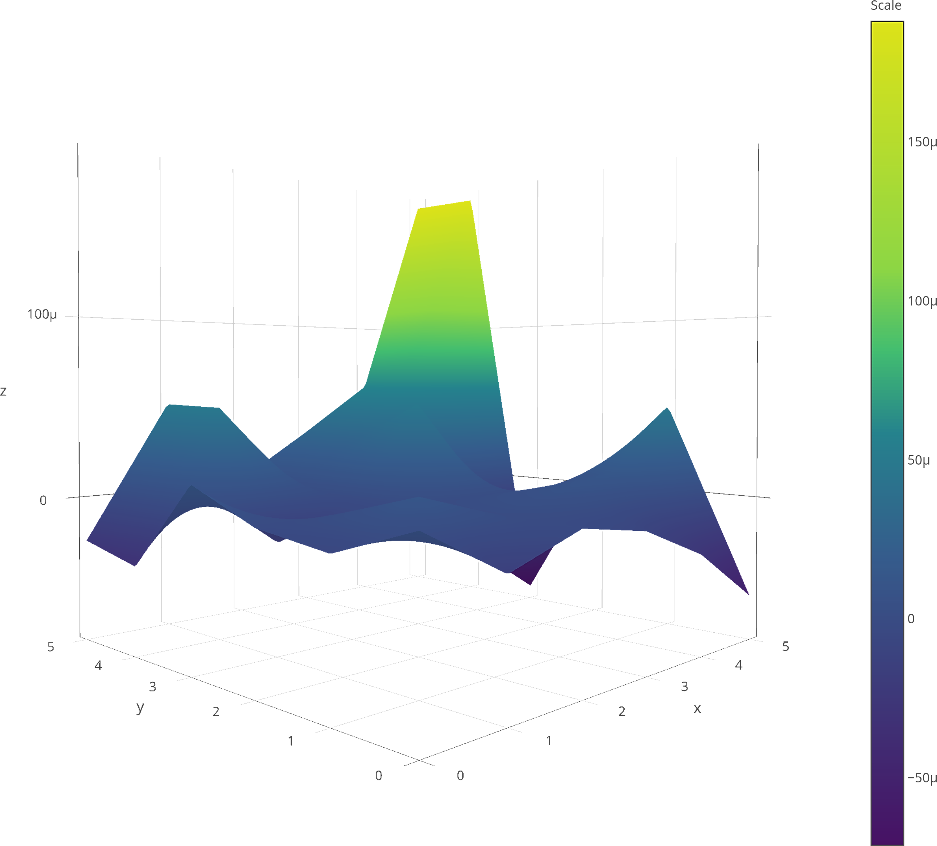
Main Contributions
Point Cloud Registration > PCR-Pro
We introduce a way of using direct SLAM approaches for multiagent SLAM systems where we do not have information of the scale difference.
We introduce feature data to featureless SLAM approaches.
We present a robust method to find an accurate transformation between sparse point clouds where the system converges to a global minimum.
The system’s covariance is very small, which will help in the usage of the information matrix and will solve many existing problems related to relative transformation estimation.

Slide 13
Place Recognition – Image Retrieval > MAQBOOL
Multiple AcQuisitions of perceptiBle regiOns for priOr Learning
3
MAQBOOL
In robotics, the place recognition module should not be tightly coupled with the GPS or 3D data. Otherwise, it will become harder for the server of the multi-agent SLAM system to handle.
Our proposed method requires little training, and it works excellently when tested on different datasets. MAQBOOL probabilistically elevates the perceptible regions’ distributions for improving the loop closure module of the multiagent SLAM system.
M Usman Maqbool Bhutta, Sun, Y. , and Liu, M., “Why-So-Deep: Image correspondence verification by probabilistic spatial landmarks elevation for visual place recognition.” Manuscript submitted for publication*.

Slide 14
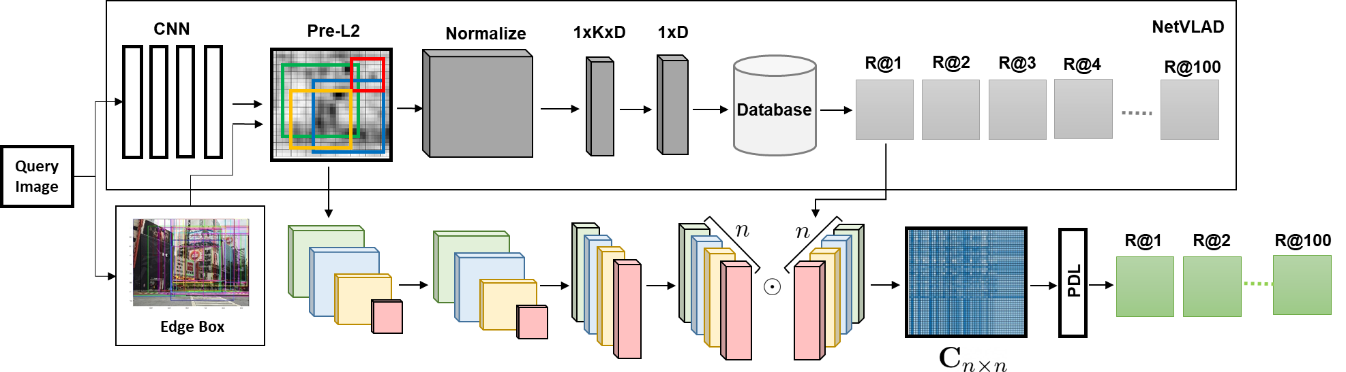
Main Contributions
Place Recognition > MAQBOOL
Our main contribution is to re-rank the retrieved images based on prominent regions of the query images.
We introduce a probabilistic layer to constrain the local representation along with the global representation of images. The global description of the pre-trained model and the local consistency introduced in our work enables the system to yield good performance at large-scale.
[1] Arandjelovic, R., Gronat, P., Torii, A., Pajdla, T., & Sivic, J. (2016). NetVLAD: CNN architecture for weakly supervised place recognition. In Proceedings of the IEEE conference on computer vision and pattern recognition (pp. 5297-5307).

Slide 15
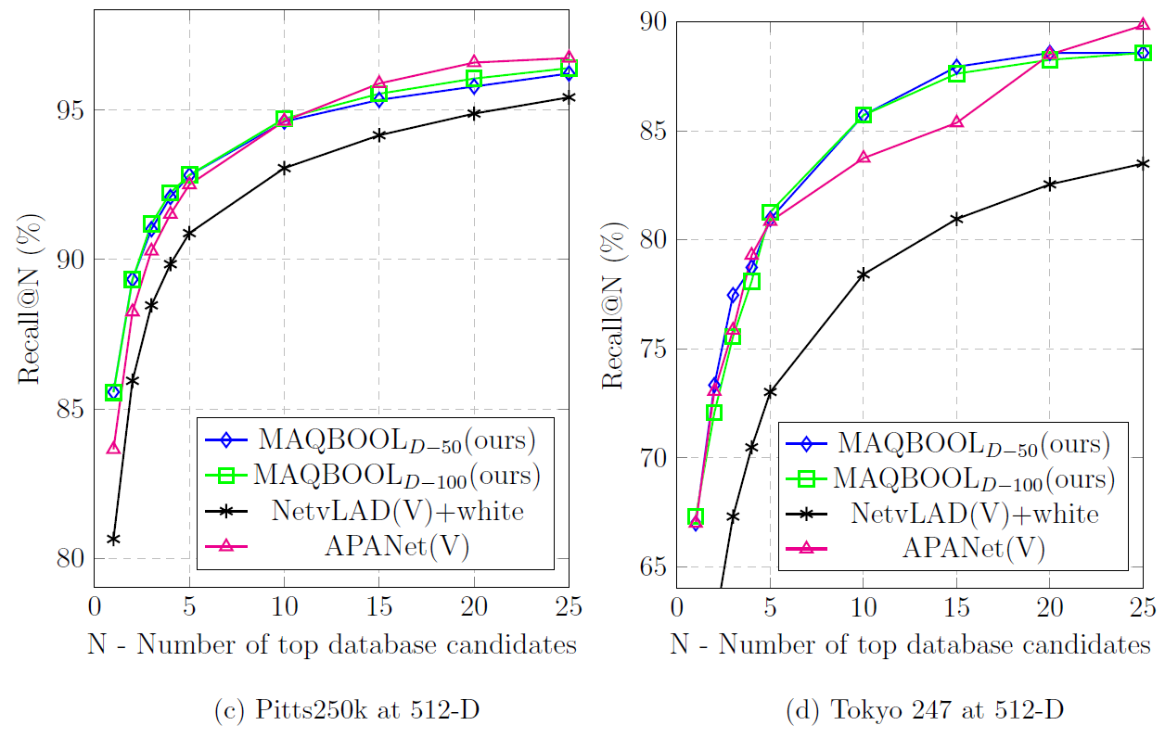
Main Contributions
Place Recognition > MAQBOOL
Our main contribution is to re-rank the retrieved images based on prominent regions of the query images.
We introduce a probabilistic layer to constrain the local representation along with the global representation of images. The global description of the pre-trained model and the local consistency introduced in our work enables the system to yield good performance at large-scale.
Our system shows comparable accuracy at a low descriptor dimension (512-D) compared to the high descriptor dimension (4096-D) of the current state-of-the-art [1].
Trained on Pittsburg dataset
Trained on Tokyo 24/7 dataset
[1] Arandjelovic, R., Gronat, P., Torii, A., Pajdla, T., & Sivic, J. (2016). NetVLAD: CNN architecture for weakly supervised place recognition. In Proceedings of the IEEE conference on computer vision and pattern recognition (pp. 5297-5307)
[2] Y. Zhu, J. Wang, L. Xie, and L. Zheng, “Attention-based pyramid aggregation network for visual place recognition,” in Proceedings of the 26th ACM international conference on Multimedia, pp. 99–107, 2018. .

Slide 16
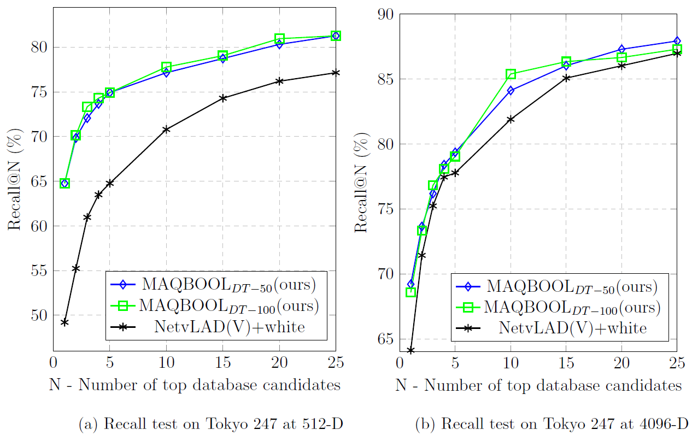
Main Contributions
Place Recognition > MAQBOOL
Our main contribution is to re-rank the retrieved images based on prominent regions of the query images.
We introduce a probabilistic layer to constrain the local representation along with the global representation of images. The global description of the pre-trained model and the local consistency introduced in our work enables the system to yield good performance at large-scale.
Our system shows comparable accuracy at a low descriptor dimension (512-D) compared to the high descriptor dimension (4096-D) of the current state-of-the-art [1].
In our results, we show the significant performance of our system at low-dimensional features with a previously trained model on different datasets.
Trained on Pittsburg dataset
[1] Arandjelovic, R., Gronat, P., Torii, A., Pajdla, T., & Sivic, J. (2016). NetVLAD: CNN architecture for weakly supervised place recognition. In Proceedings of the IEEE conference on computer vision and pattern recognition (pp. 5297-5307).

Slide 17
Automation - Inspection
Automation > Smart-Inspect
4
Smart-Inspect
Bhutta, M.U.M., Aslam, S., Yun, P., Jiao, J. and Liu, M., 2020. Smart-Inspect: Micro Scale Localization and Classification of Smartphone Glass Defects for Industrial Automation. arXiv e-prints, pp.arXiv-2020.
Patent (under-review)
The patent titled ”Automatic Surface Defect Detection System for SmartPhone Glass Based on Deep Learning. The co-investigators are Jianhao Jiao, Peng Yun, Yuan Wang, Xuebin Sun, and Ming Liu.

Slide 18
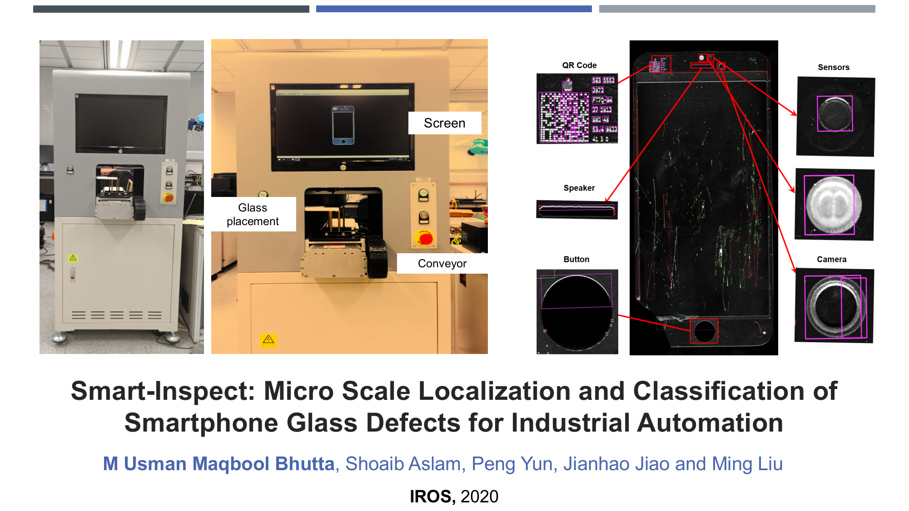
Main Contributions
Automation > Smart-Inspect
Smart-Inspect can work on raw images (without any enhancement) and full smartphone glass images (with-out any cropping). This makes it much more powerful and efficient than the current state-of-the-art techniques[1,2], which can perform only after taking the transparent glass regions by cropping the sides of the glass.
Our method outperforms in precise localization and accurate classification of tiny defects (5 microns) that the human eye cannot see.
[1] D. Li, L.-Q. Liang, and W.-J. Zhang, “Defect inspection and extraction of the mobile phone cover glass based on the principal components analysis, ”The International Journal of Advanced Manufacturing Technology, vol. 73, no. 9-12, pp. 1605–1614, 2014.
[2] H.-g. Liu, Y.-p. Chen, X.-q. Peng, and J.-m. Xie, “A classification method of glass defect based on multi resolution and information fusion,”The International Journal of AdvancedManufacturing Technology, vol. 56, no. 9-12, pp. 1079–1090, 2011.

Slide 19
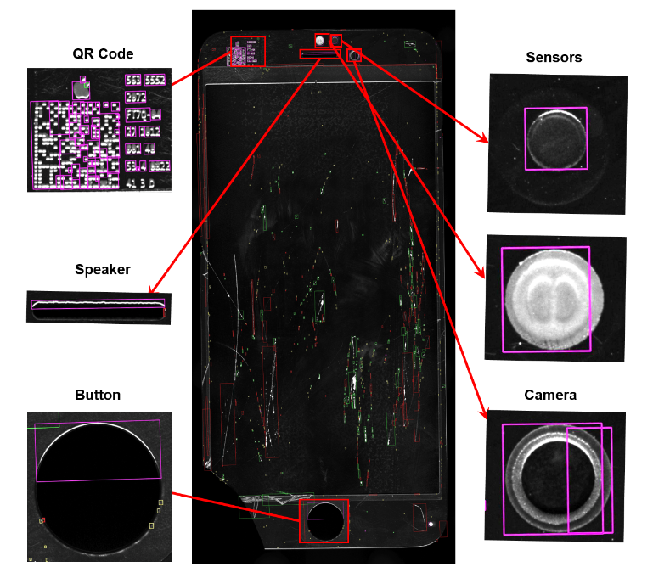
Main Contributions
Automation > Smart-Inspect
Smart-Inspect can work on raw images (without any enhancement) and full smartphone glass images (with-out any cropping). This makes it much more powerful and efficient than the current state-of-the-art techniques[1,2], which can perform only after taking the transparent glass regions by cropping the sides of the glass.
Our method outperforms in precise localization and accurate classification of tiny defects (5 microns) that the human eye cannot see.
We propose a robust method for the localization and classification of defect and non-defect regions where the system has excellent performance based on a partially labeled small dataset.
Smart-Inspect enables a system for precise labelling of large datasets of smartphone glass with high accuracy.
[1] D. Li, L.-Q. Liang, and W.-J. Zhang, “Defect inspection and extraction of the mobile phone cover glass based on the principal components analysis, ”The International Journal of Advanced Manufacturing Technology, vol. 73, no. 9-12, pp. 1605–1614, 2014.
[2] H.-g. Liu, Y.-p. Chen, X.-q. Peng, and J.-m. Xie, “A classification method of glass defect based on multi resolution and information fusion,”The International Journal of AdvancedManufacturing Technology, vol. 56, no. 9-12, pp. 1079–1090, 2011.

Slide 20
Future Work
AR/VR
Interior and exterior designing,
Development of advanced games,
Autonomous driving, and
Smart cities
View-Tags and Holography
View Tags of size 15kbt per keyframe. (20% of the size of the original image) will be the best combination to handle a lot of keyframes.
It can be used with a system like Loop-box for connecting agents.
Expected Patents View-Tags
View-tags are low-weight with high performance and loop closure detection tags.
Inspection System
Robotic inspection for large structures, combining my SLAM and inspection related work.
It is more interesting with the usage of deep learning techniques for industrial inspection.

Slide 21
Publications
Recent Research Work
Bhutta, M.U.M., Sun, Y. , and Liu, M., “Why-So-Deep: Image correspondence verification by probabilistic spatial landmarks elevation for visual place recognition.” Manuscript submitted for publication.
Bhutta, M.U.M., Aslam, S., Yun, P., Jiao, J. and Liu, M., 2020. Smart-Inspect: Micro Scale Localization and Classification of Smartphone Glass Defects for Industrial Automation. arXiv e-prints, pp.arXiv-2020.
Bhutta, M.U.M., Kuse, M., Fan, R., Liu, Y. and Liu, M., 2020. Loop-box: Multiagent direct slam triggered by single loop closure for large-scale mapping. IEEE transactions on cybernetics.
Ma, H., Ma, Y., Jiao, J., Bhutta, M.U.M., Bocus, M.J., Wang, L., Liu, M. and Fan, R., 2018, October. Multiple lane detection algorithm based on optimised dense disparity map estimation. In 2018 IEEE International Conference on Imaging Systems and Techniques (IST) (pp. 1-5). IEEE.
Bhutta, M.U.M. and Liu, M., 2018, July. Pcr-pro: 3d sparse and different scale point clouds registration and robust estimation of information matrix for pose graph slam. In 2018 IEEE 8th Annual International Conference on CYBER Technology in Automation, Control, and Intelligent Systems (CYBER) (pp. 354-359). IEEE.
Zoha Qamar, Bushra Yaseen, and Usman Maqbool, Efficient reset design techniques, Science International, ISSN 1013-5316, vol. 27, no. 2, pp. 1671–1674, 2015.
Bhutta, M.U.M., Mahmood, H. and Malik, H., 2014, July. An intelligent approach for robust detection and recognition of multiple color and font styles automobiles license plates: A feature-based algorithm. In 2014 International Conference on Audio, Language and Image Processing (pp. 956-961). IEEE.

Slide 22



Education
PhD. in Electronic and Computer Engineering
(Sep 2016-Feb 2021) Research: Robotics and AI (Multi-Agent SLAM System) Supervisor: Prof. Ming Liu, Director of Robotics and Multiperception Lab. School: Department of Electronic and Computer Engineering, The Hong Kong University of Science and Technology, HKUST, HK (Top 15 in Engineering and Technology in World). Scholarship: Punjab Endowment Funds CCMS PhD Merit Scholarship SSMS, Pakistan.
M.Phil. in Electronics
(2010-2012) Research: Image processing and communication. Supervisor: Prof. Hasan Mahmood. School: Department of Electronics, Quaid-i-Azam University, QAU,Islamabad, Pakistan.
M.Sc. in Electronics
(2007-2009) School: Department of Electronics, Quaid-i-Azam University, QAU,Islamabad, Pakistan. Scholarship: HEC position based Scholarship (three times) during M.Sc. (Electronics) at QAU.
B.Sc. in Mathematics and Physics
(2005-2007) School: Bahauddin Zakariya University, BZU, Multan, Pakistan.

Slide 23








Experience
Academic
OCT 19 – MAR 20 | Autonomous Systems Lab(ASL),ETH Zürich
Post: Academic Guest, Autonomous Systems Lab(ASL),ETH Zürich, Switzerland Experience: I’ve mainly work for the better place recogition using deep learning under the supervision of Dr. Cesar Cadena and Prof. Roland Siegwart.
OCT 15 – MAY 16 | BZU Sahiwal Campus and Government PG College Sahiwal, Pakistan
Post: Lecture Visiting, Department of Computer Science (BZU – Sahiwal Campus) and Department of Physics, Government PG College Sahiwal Experience: Teaching Digital Electronics I, Digital Electronics II, Analog Electronics I and related labs. Worked as Project Supervisor for Bachelors students.
FALL 2010 | Quaid-i-Azam University, Islamabad, Pakistan.
Post: Instructor Experience: Teaching ‘PHP/MySQL Web Applications Development’ (a short course) offered in Department of Electronics, Quaid-i-Azam University, Islamabad, Pakistan
Industry
Jan 18 – Present | Lisee Technology Corporation Limited.
Post: Chief Operating Officer (COO) Experience: Won funding support for company | TSSSU Support HK$ 300,000 (Jun 19 - May 20). Indoor Navigation for Libray using Lisee Technology | PCF Support HK$ 160,000 (Jun 18 - May 19).
FEB 13 – AUG 15 | Friends Corporate Technologies.
Post: Chief Executive Officer (CEO) Experience: 50+ Projects | Electronics/ Electrical Engineering, R&D, image processing, Web Applications Development, MVC Applications. Further Details: Being entrepreneur, I started my company ‘Friends Corporate Technologies’ in 2013.
MAY 12 - FEB 13 | Federal Government of Pakistan.
Post: Scientific Officer(SPS-8) Experience: Electronics / Electrical Engineering, R&D, image processing.
DEC 09-MAR 10 | Server4sale, Islamabad, Pakistan.
Post: PHP Developer Experience: MVC, Joomla, Zend Framework using Eclipse IDE at Server4sale, LLC, G-10/2 Islamabad, Pakistan.

